Slide 1
Andrei hurried to school and turned onto the wrong path. He got lost. Help Holmes follow the trail and find Andrey.

Slide 2
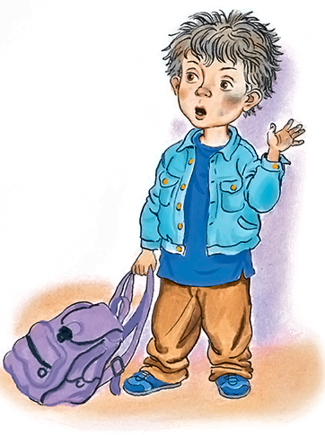
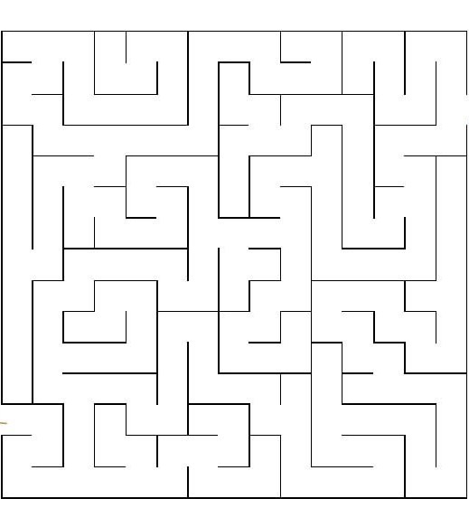
Nick … from Australia.
am
is
are

Slide 3
I … ten years old.
am
is
are

Slide 4
Liza … good at swimming.
am
is
are

Slide 5
My friends … kind and brave.
am
is
are

Slide 6
Susan … a little girl.
am
is
are

Slide 7
My parents … very joyful.
am
is
are

Slide 8
My grandpa … not very old.
am
is
are

Slide 9
I … a good pupil.
am
is
are

Slide 10
Her name … Pamela.
am
is
are

Slide 11
Karen … my elder sister.
am
is
are

Slide 12
Sam and Kate … my best friends.
am
is
are

Slide 13
Holmes! I’m here!

